Slide 1
Team 21`s
C Programming final project
Book Database

Slide 2
Contents of the presentation
Info – gathering
Planning
Work-load distribution
Functionality

Slide 3
Information gathering
The information gathered by the team was mainly brainstorming ideas.
Similar real-life projects were taken as an inspiration, for example the Misr Public Library (MPL) as well as Worldcat.org
Info-gathering

Slide 4
Planning
The team met on the 30th of May to brainstorm ideas and discuss the project details, such as the requirements of the project.
The information gathered by the team helped establish a good understanding of the project’s outcome.
Info-gathering
Team’s first meeting

Slide 5
Workload distribution
Ahmed Hassan
Delete all function
Sell function
Mostafa
Instruction function
Delete-id function
Ahmed Hamdy
Insert function
Ammar
Search function
Ahmed Mostafa
Test function
Write function
Display function
Main function
Info-gathering
Team’s first meeting
Workload distribution

Slide 6
Synchronizing work
The team met for the second time on the 8th of June, this meeting’s purpose was to check on the current work and solve any problems that was faced.
Info-gathering
Team’s first meeting
Workload distribution
Team’s second meeting

Slide 7
Functionality
In total, there are 8 different functions in this program along side the main function the connects all of them in loops.
Here are the functions along their functionality:
Insert (Takes all the user inputs and inserts it in the struct )
Delete-id, name (Takes the id or name from user to delete all values associated with it )
Info-gathering
Team’s first meeting
Workload distribution
Team’s second meeting
Functionality

Slide 8
Functionality
Search (Takes the book’s id form user and searches it in the database)
Display(Displays all the data in the database)
Test(Checks if the inserted id matches an existing book in the database)
Instructions(Displays the main menu and takes the user’s input)
Write(Writes the input values in the file “database”)
Sell(takes away the number of sold books from the total number of books in the database, also calculates the total price)
Info-gathering
Team’s first meeting
Workload distribution
Team’s second meeting
Functionality

Slide 9
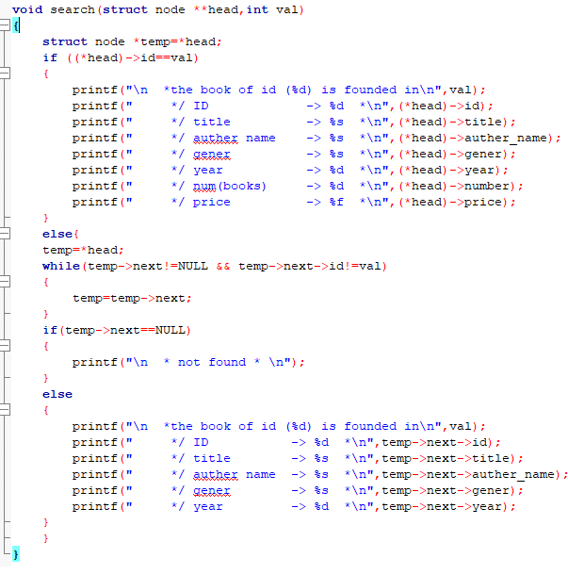
Sample code: Search function

Slide 10
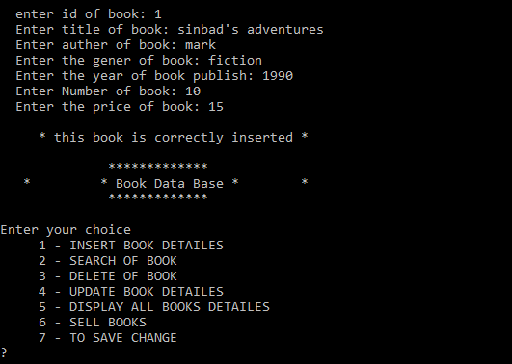
Sample program:

Slide 11
Thank you for listening

